Slide 1
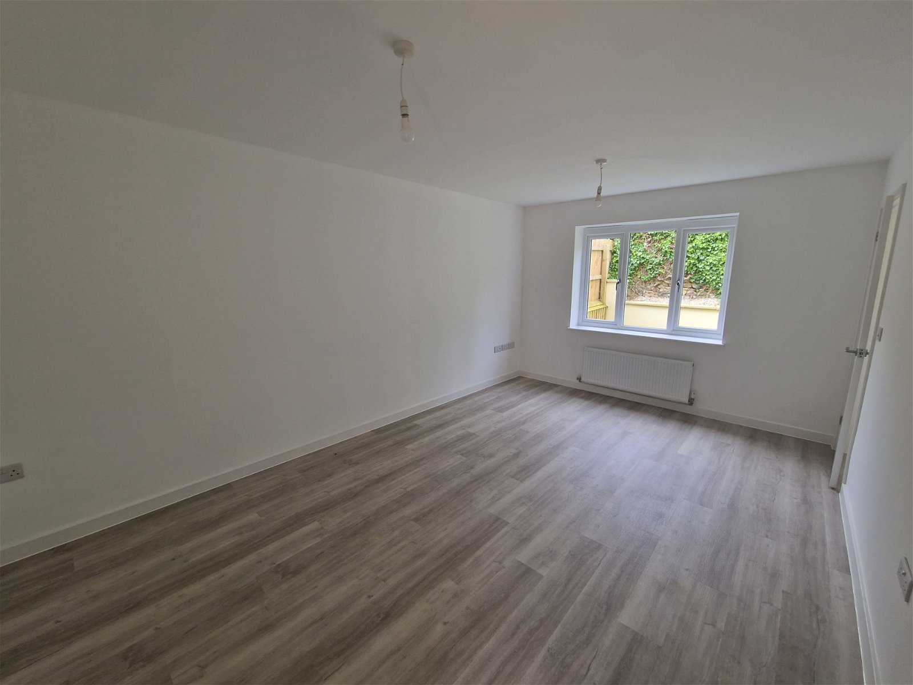
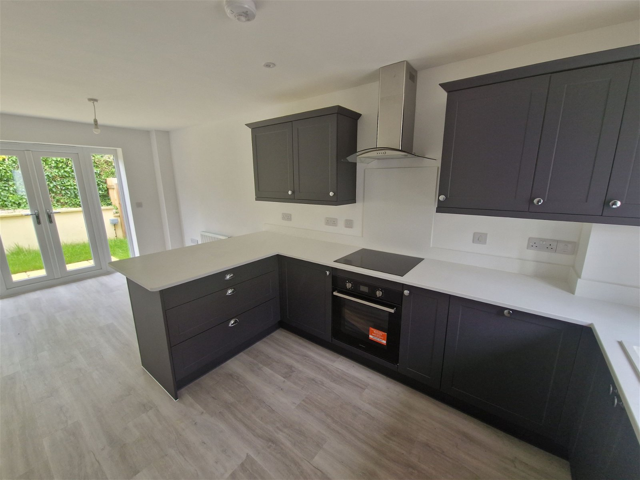
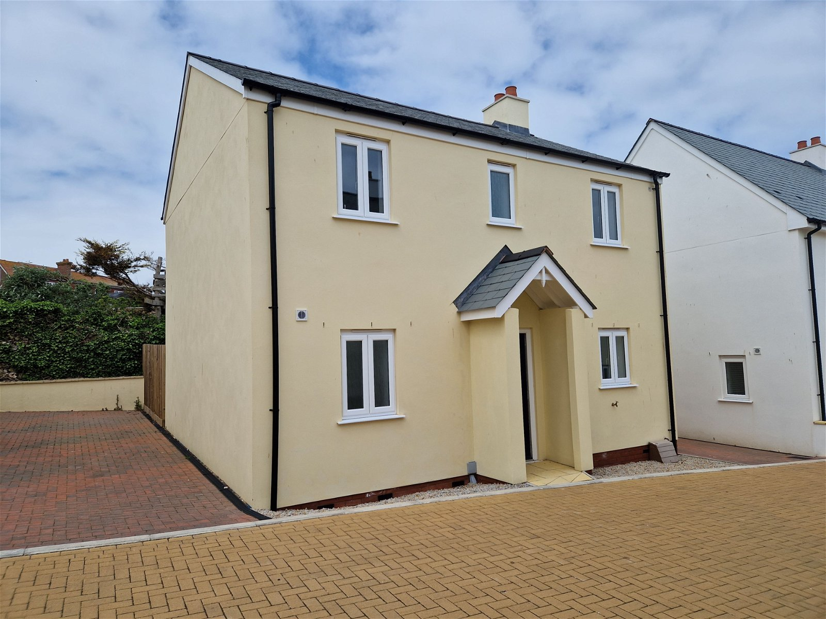
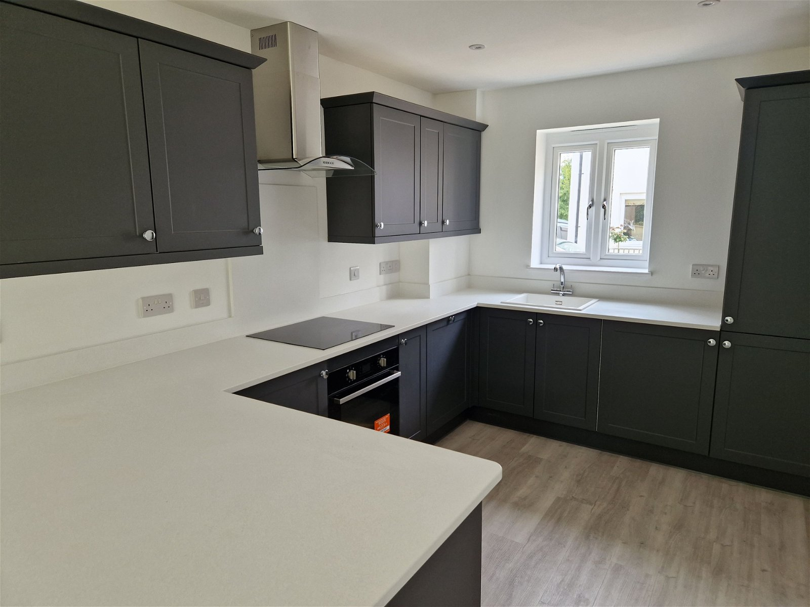
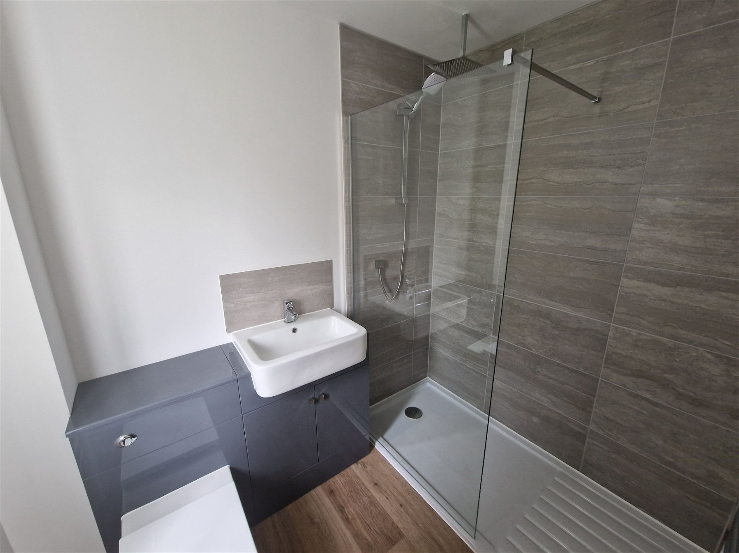
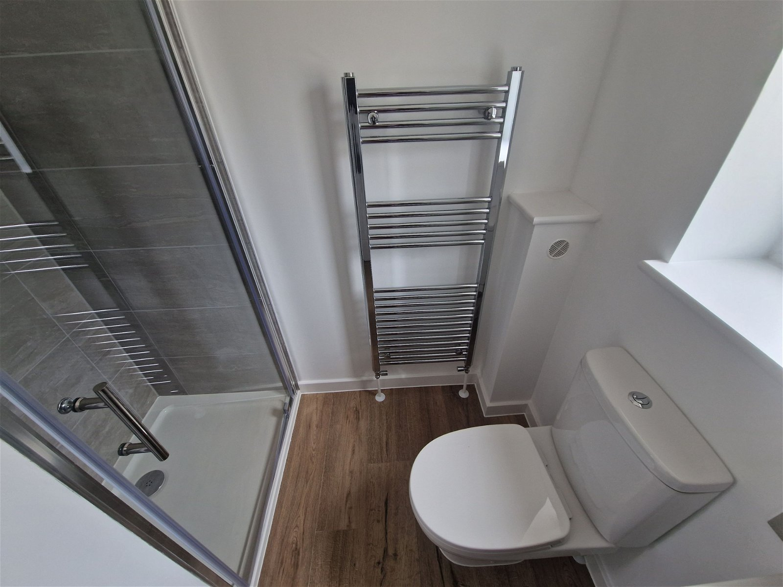
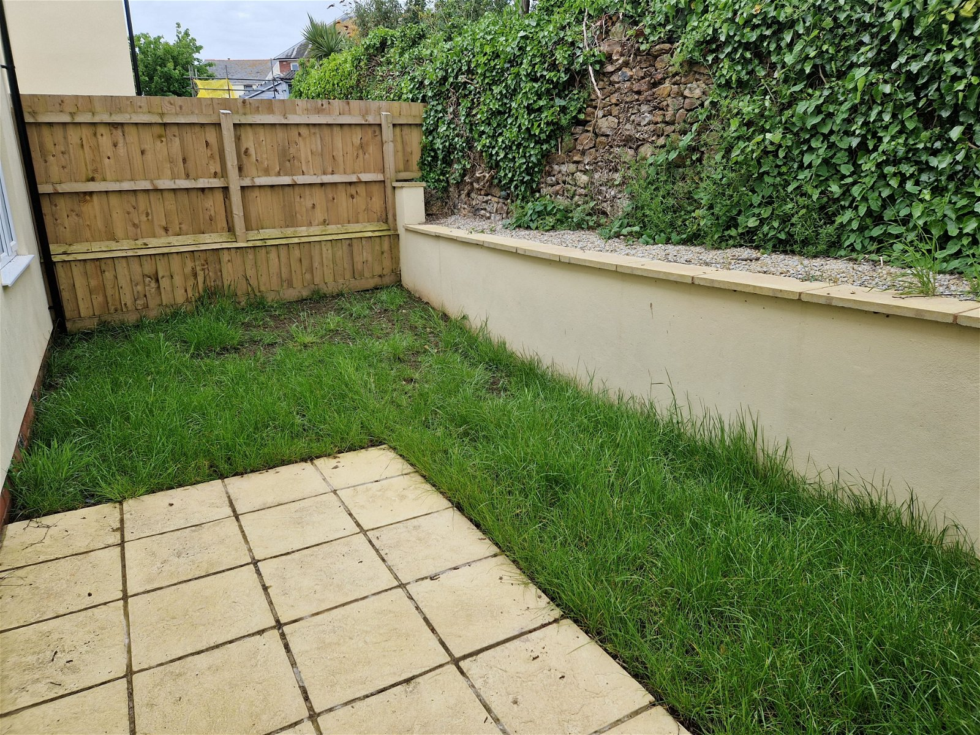
www.pennys.net
Plot 3 Driftwood, Fore street, Seaton, EX12 2AD
GUIDE PRICE £365,000
TENURE Freehold
A BRAND NEW DETACHED HOUSE Ideally Located Close To The Town Centre And Beach.
LAST PLOT REMAINING ON THIS SELCT NEW DEVELOPMENT •
Lounge • Cloakroom/WC •
Quality Kitchen With Built In Appliances/Dining Room •
Three Bedrooms - En-Suite Quality Shower Room/WC • Family Quality Bathroom • Driveway parking And enclosed Gardens • Guarantees Included •
Ready For Occupation •
Pennys Estate Agents Limited for themselves and for the vendor of this property whose agents they are give notice that:- (1) These particulars do not constitute any part of an offer or a contract. (2) All statements contained in these particulars are made without responsibility on the part of Pennys Estate Agents Limited. (3) None of the statements contained in these particulars are to be relied upon as a statement or representation of fact. (4) Any intending purchaser must satisfy himself/herself by inspection or otherwise as to the correctness of each of the statements contained in these particulars. (5) The vendor does not make or give and neither do Pennys Estate Agents Limited nor any person in their employment has any authority to make or give any representation or warranty whatever in relation to this property.
PENNYS ESTATE AGENTS
2 Rolle House, Rolle Street, Exmouth, Devon, EX8 2SN
Tel: 01395 264111 EMail: help@pennys.net

Slide 2
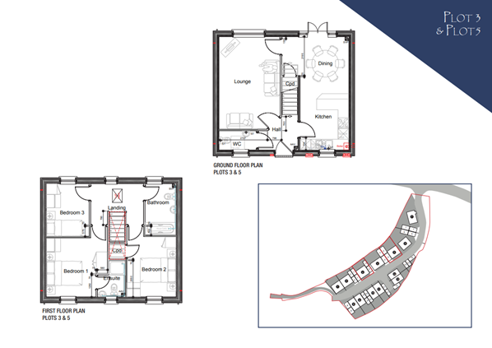
Plot 3 Driftwood, Fore Street, Seaton, EX12 2AD
THE PROPERTY COMPRISES: OPEN ENTRANCE PORCH: With light; composite front door to: ENTRANCE HALL: Wood laminate flooring; stairs to first floor landing; electric consumer unit. CLOAKROOM/WC: With pedestal wash hand basin; WC with push button flush; double glazed window; wood laminate flooring. LOUNGE: 5.13m x 3.35m (16'10" x 11'0") Radiator; two TV points; double glazed window to rear aspect; wood laminate flooring; door to: KITCHEN/DINING ROOM: 6.35m x 2.67m (20'10" x 8'9") Quality kitchen with integrated appliances including fridge freezer; washing machine; oven, hob and chimney style extractor hood over. Range of work tops with inset sink unit with matching cupboards; wall mounted gas boiler; wood laminate flooring; double glazed window to front aspect and double doors to rear aspect; radiator; access to understairs cupboard. FIRST FLOOR LANDING: Double glazed window; access to roof space. BEDROOM ONE: 3.86m x 3.35m (12'8" max x 11'0") Double glazed window to front aspect; telephone point; TV point; door to: EN-SUITE SHOWER ROOM: Shower cubicle with rainfall shower head; pedestal wash hand basin; WC with push button flush; chrome heated towel rail; shaver socket; double glazed window. BEDROOM: 2: 3.86m x 2.67m (12'8" x 8'9") Double glazed window to front aspect; TV point; radiator; built in cupboard. BEDROOM THREE: 2.9m x 2.34m (9'6" x 7'8") Double glazed window to rear aspect; radiator; TV point. BATHROOM/WC: 2.34m x 1.68m (7'8" x 5'6") Double width shower cubicle with rainfall shower head and detachable hose; wash hand basin set into display surface with cupboard; WC with push button flush; chrome heated towel rail; double glazed window.
OUTSIDE: Driveway parking to side of house. Dry stone front garden with outside tap. Side gate gives access to enclosed rear garden with patio and light and outside, power socket and electric car charging point.

